Slide 1
Washington State
Elementary Secondary Education Act
Waiver

Slide 2
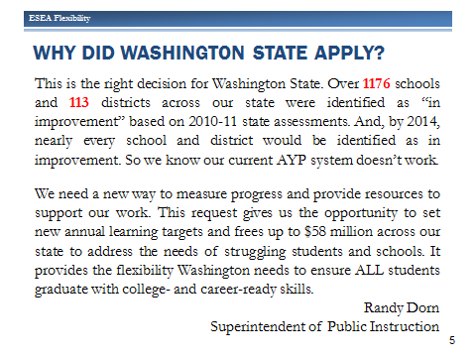

Slide 3
Implications of the Waiver
Adoption of the Common Core State Standards
Implementation of new teacher and principal evaluations
New measures of accountability

Slide 4
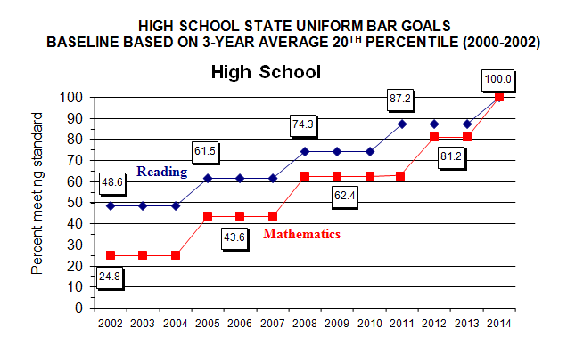
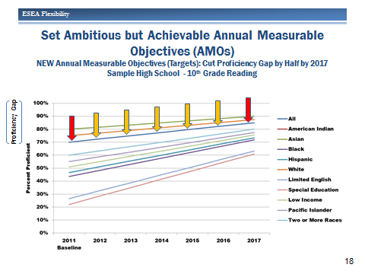
A New Measure of Accountability
Adequate Yearly Progress
Annual Measurable Objectives

Slide 5
The Same…But Different
The Uniform Bar
The Annual Objectives
Monitored student achievement for ALL students.
Monitored student achievement of particular subgroups.
Measured each groups approximation of the uniform bar.
Identified schools as being at different “Steps” for improvement based on number times they have not met the uniform bar.
Affects schools accepting Title One services and funds.
Monitors student achievement for ALL students.
Monitors student achievement of particular subgroups.
Measures each groups progress toward their distinct annual objective.
Categorizes school’s subgroup performance and labels school’s that fall into the bottom 15% of performance.
Affects schools accepting Title One services and funds.

Slide 6


Identification of School’s
Priority Schools
are among the lowest 5% of Title I schools in the state based on overall student performance on state assessments.
Focus Schools
are among the lowest 10% of Title I schools in the state based on subgroup performance on state assessments.
Emerging Schools: Other low performing Title I schools.
WIS
Next 10% from the Focus rank
Next 5% from the Priority rank
Bottom 5%
Bottom 10%

Slide 7
GOOD NEWS!!!

Slide 8
Annual Measurable Objectives
To Be Announced…..

